Slide 1

IPL WIN PREDICTION
Sandhiya K U
DADS - OCT 2024

Slide 2
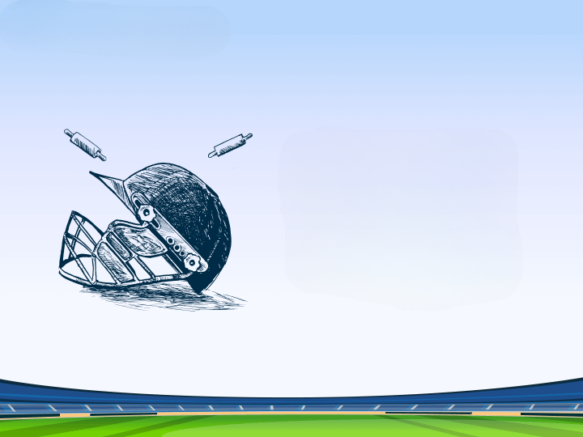
INTRODUCTION
Overview
Match-level information from IPL tournaments.
Includes:
Team details
Match results
Toss Outcomes
Venue
Performance Indicators
Objective
Predict the winner of an IPL match based on various features

Slide 3

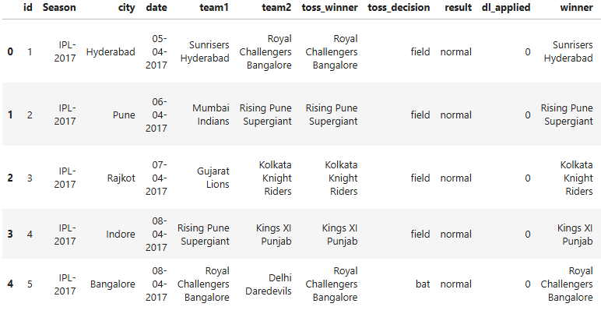
DATA UNDERSTANDING
Structure – 756,18
Starting and ending table
Information
Descriptive Statistics

Slide 4
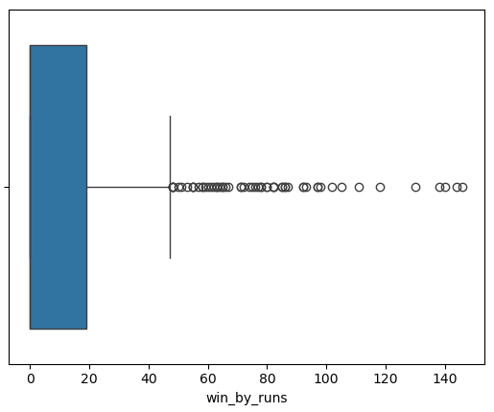
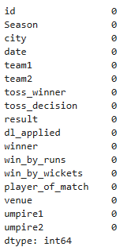
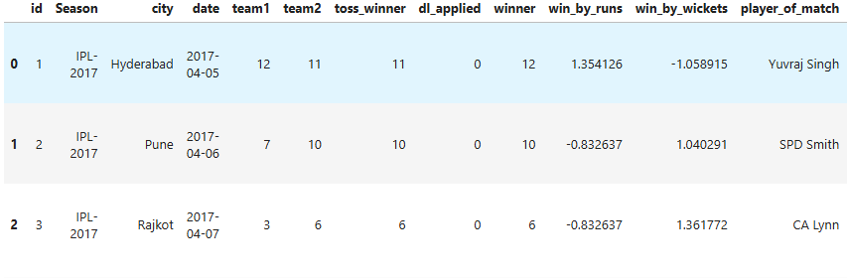
DATA CLEANING & PREPROCESSING
Cleaning:
Handling null values
Removing duplicates
Removing unnecessary columns
Preprocessing:
Handling outliers
Encoding
Label encoding
One-Hot encoding
Scaling – Standard Scaling
Split the dataset

Slide 5
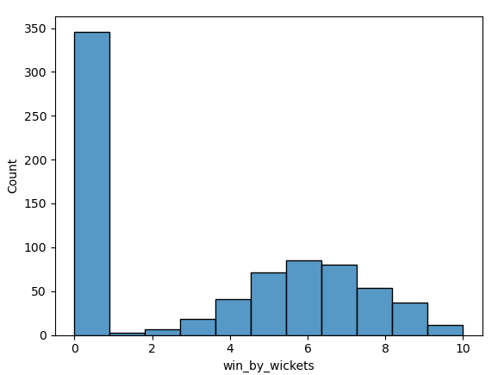
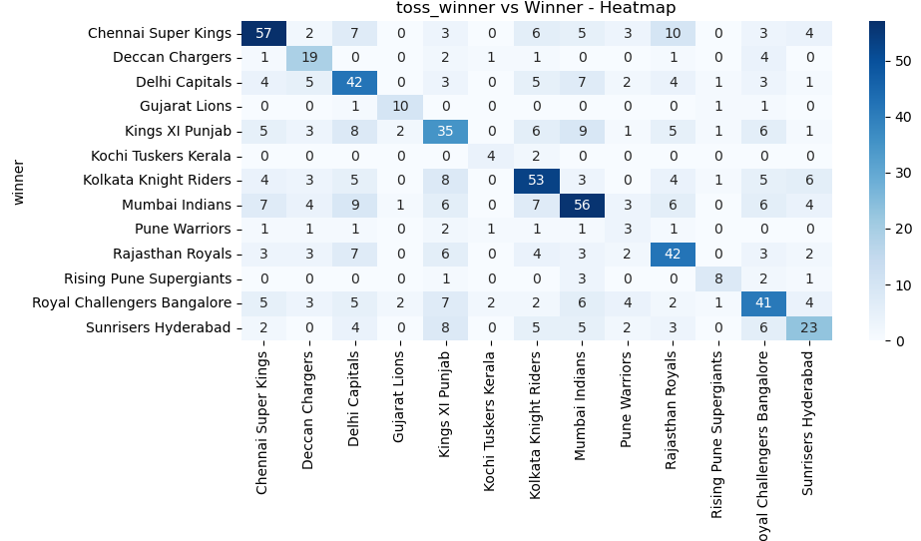
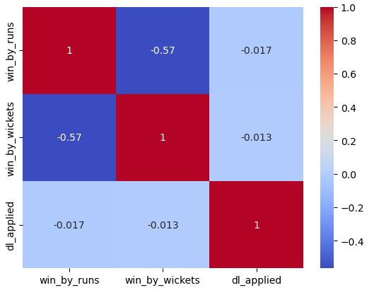
EXPLORATORY DATA ANALYSIS (EDA)

Slide 6

MODELING PROCESS
Models:
Logistic Regression
Support Vector Machine (SVM)
KNN
Decision Tree
Random Forest
XG Boosting
Hyper Parameter Tuning:
GridSearch CV
Evaluation Metrics:
Accuracy
Precision
F1 Score
Recall

Slide 7
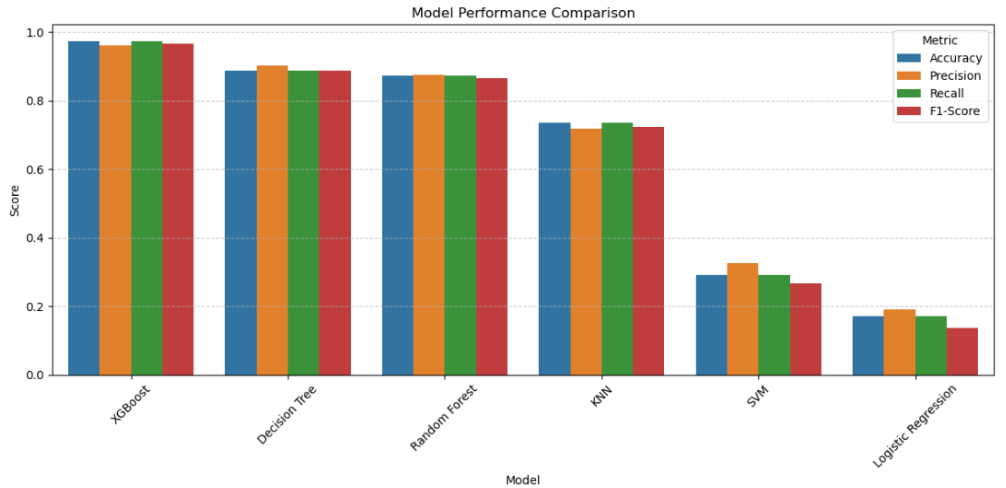
MODEL COMPARISON

Slide 8

CONCLUSION
XG Boosting – 97.35%
Capability – unseen matches
Future Steps:
Feature Engineering
Time series consideration
Advanced model:
Neural Network – better performance

Slide 9

Questions

Slide 10


